Slide 1
Logistics Tracker
-a SpringBoot Application
Team Members
Dhanush Kumaar Haridas
Pranesh Mohanraj

Slide 2
Abstract
A Spring Boot Application for tracking logistics , admin can add logistic item and edit it later based on the location the item reached. User can track the item using trackingID.

Slide 3
Video Explainer
https://drive.google.com/drive/folders/1AuxRzuSLkCz3xHqPTx49ii39cjl9p4zR

Slide 4
Modules
Login(Admin/User)
Registration for User
Admin Dashboard
Add Logistic Item
Edit Logistic Item
User Dashboard

Slide 5
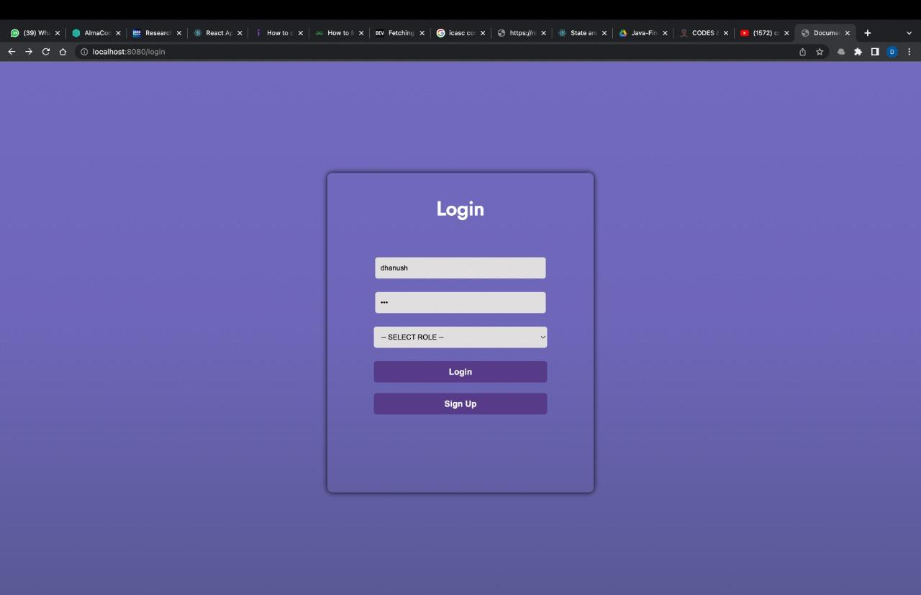
Login Module
A simple login page for both admin and user entry to the application
Login Page is rendered from “/login” endpoint .

Slide 6
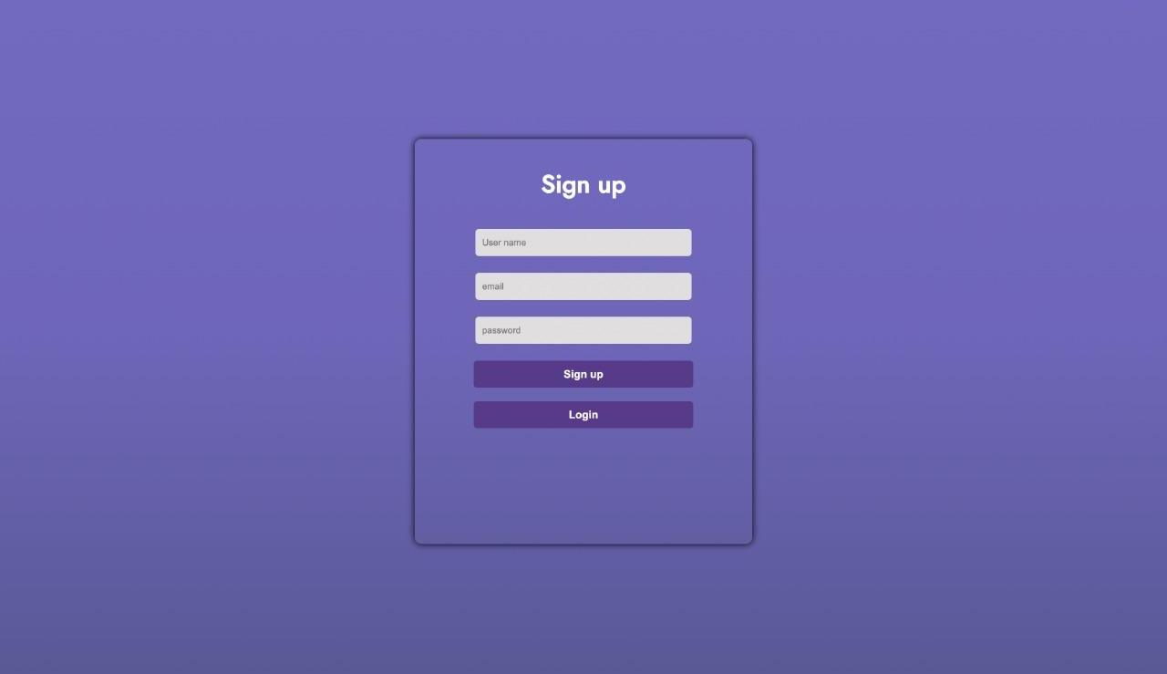
Registration
Registration Page for user to register using their credentials and login to application using it.
User credentials are stored in MySQL database
Registration is rendered from “/register“ endpoint.

Slide 7
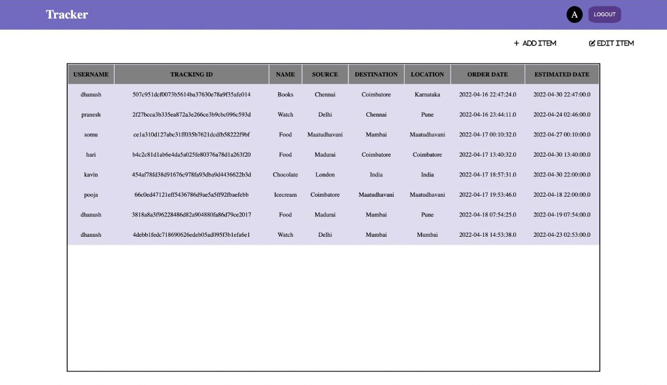
Admin Dashboard
Admin dashboard has table where items with their credentials are displayed.
It has Add Item , Edit Item and Logout inside it.

Slide 8
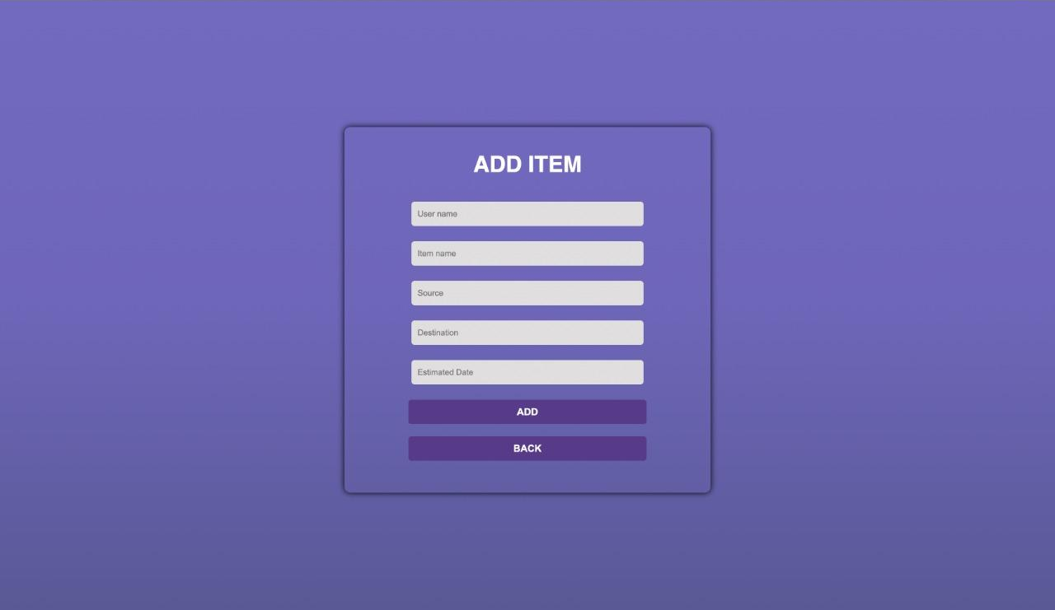
Add Item
Admin can add item in this page entering all the fields.
Endpoint for this page is “/additem”.

Slide 9
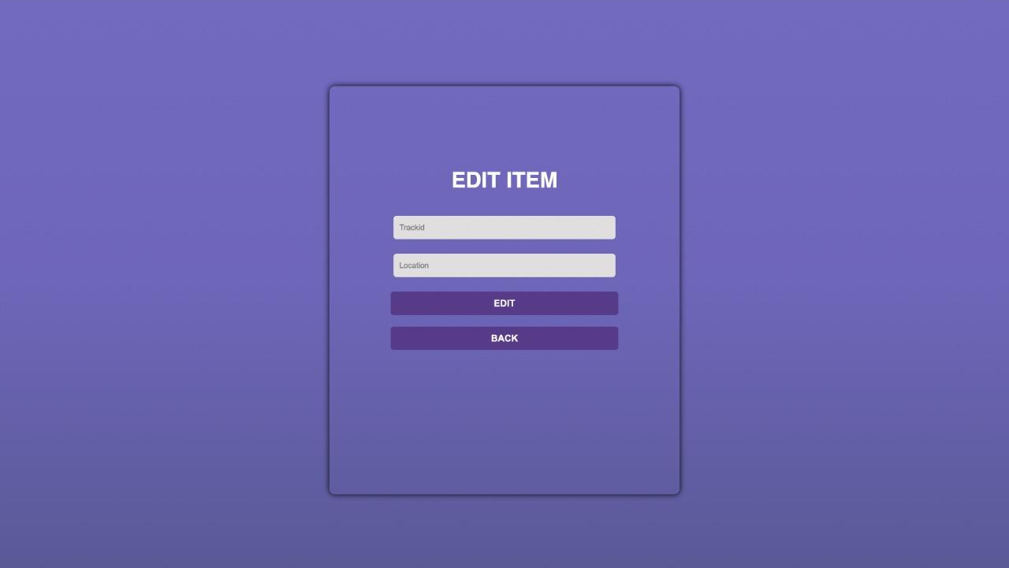
Edit Item
Admin can edit the location status of the item using trackID.
Endpoint for the page is “/edititem”

Slide 10
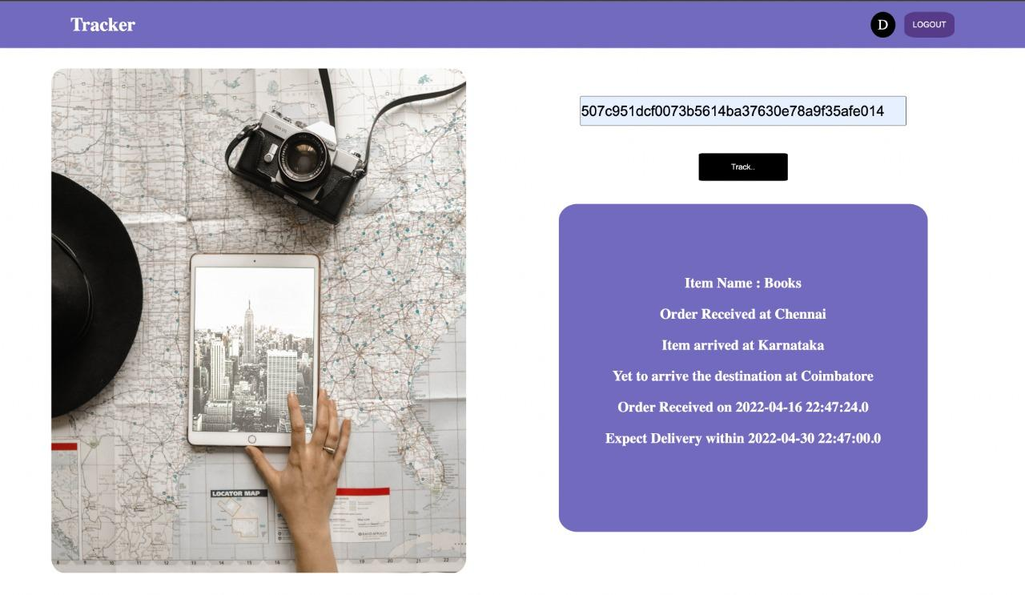
User DashBoard
User Can track his item using the trackId
This page displays the state of the courier whether it is dispatched or in specific location or reached the destination.

Slide 11
Thank You

